Slide 1
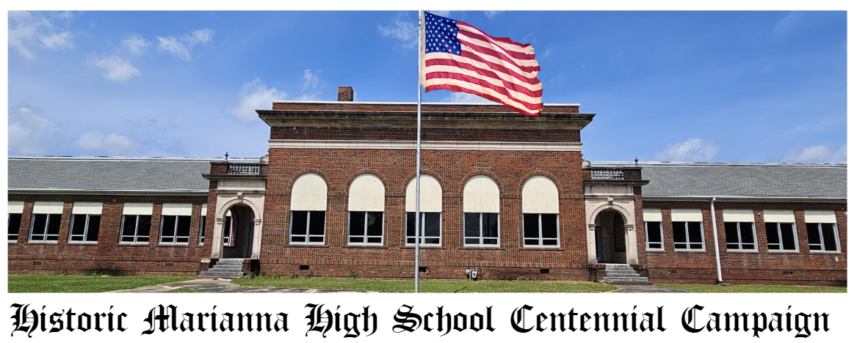

Slide 2
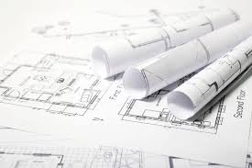
Renovation Plans

Slide 3
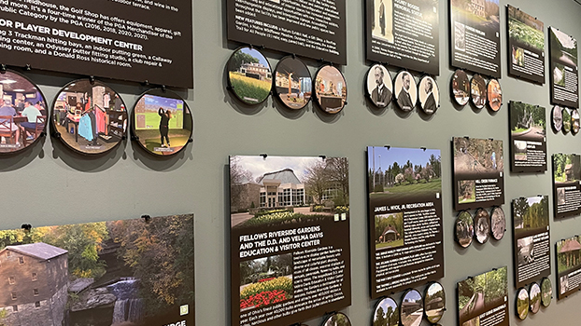
History of Marianna High School
Classroom will be renovated to showcase the history of Marianna High School over the past 100 years.
Funds raised by alumni of Marianna High will support the renovations for history museum. The top four graduating classes will be featured in the museum.

Slide 4
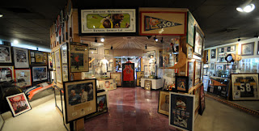
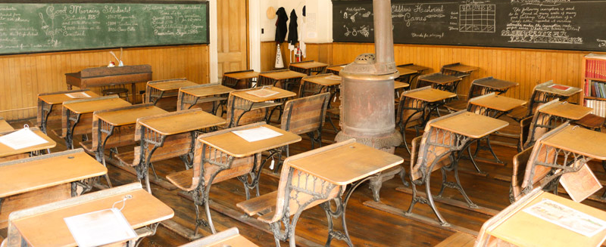
Sports and Education History of Jackson County
Schools in Jackson County will compete to raise funds to display Education and Sports History of Jackson County.
The top four schools will be featured within the museum.
Any school will have access to display donated artifacts.

Slide 5
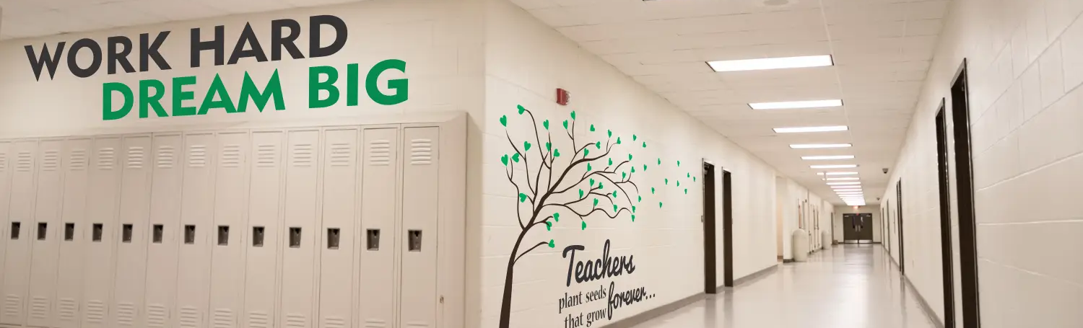
Hallway of Civic Excellence
Highlight the county’s civic engagement with the many organizations that support students and the community.
Highlight Student organizations that build leadership and well-rounded citizens.

Slide 6
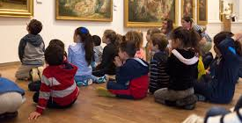

History and Civics Standards
The museum will reinforce standards in the following manner:
4th Grade Local History Standards
7th Grade Civic History Standards

Slide 7
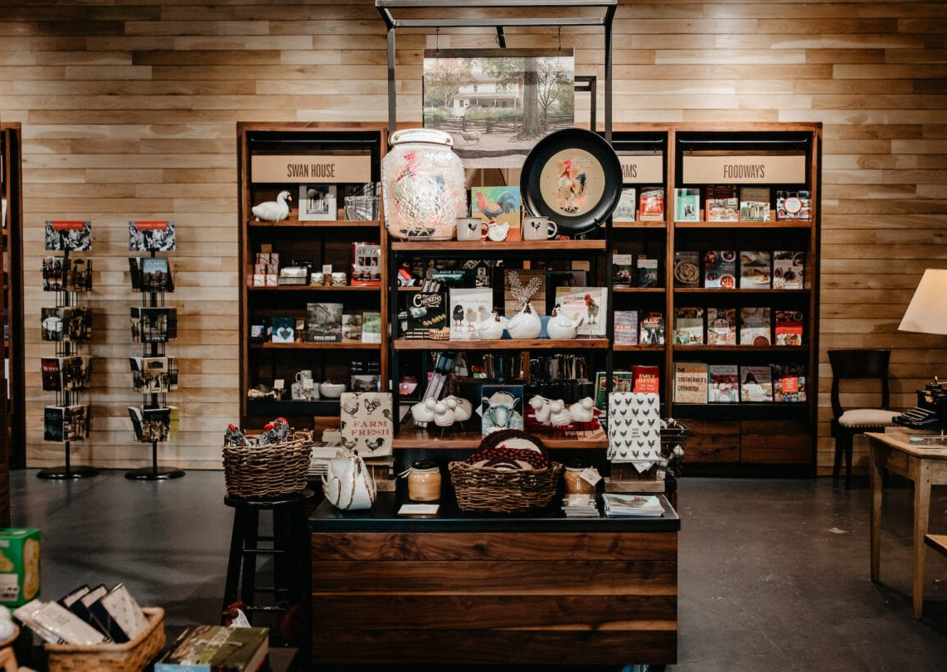
Museum Store and Classroom
Provide a museum store as a working classroom for students to manage. The program will provide students the opportunity to learn about small business management through the CTE Program for Entrepreneurship.

Slide 8
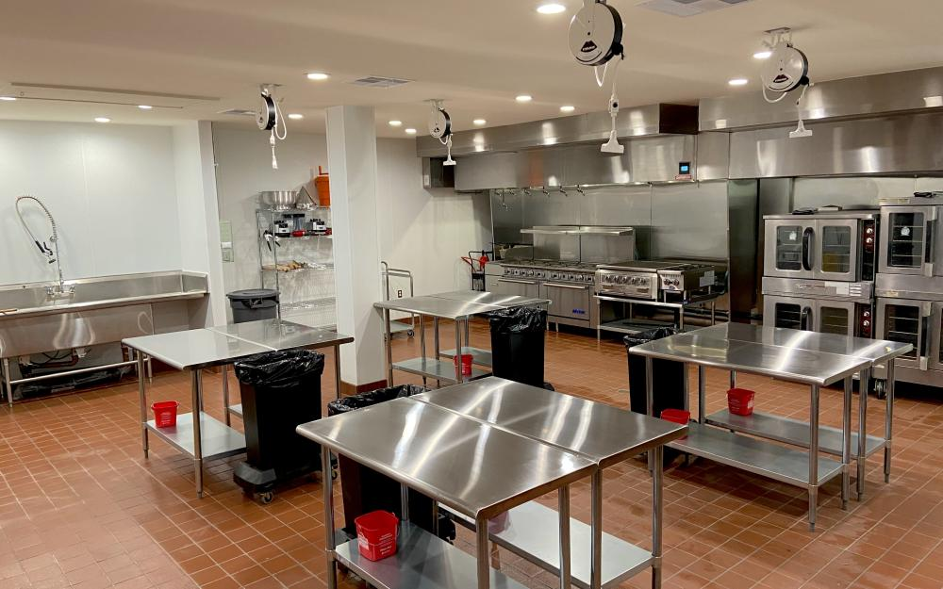
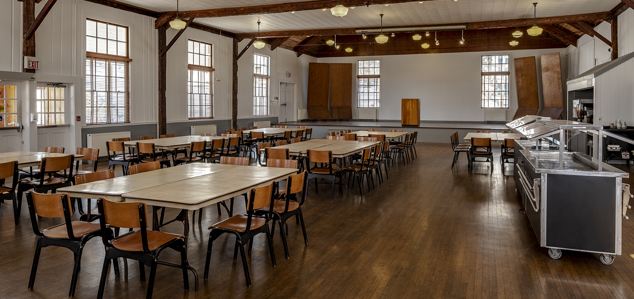
Community Events Hall
Renovate classrooms to create a community kitchen and dining area for community events like Alumni dinners, anniversaries, class reunions, civic engagement meetings, and other meetings for partner agencies.
Events can be hosted by school culinary students. Donations from businesses and individuals will be combined with grants to renovate.

Slide 9
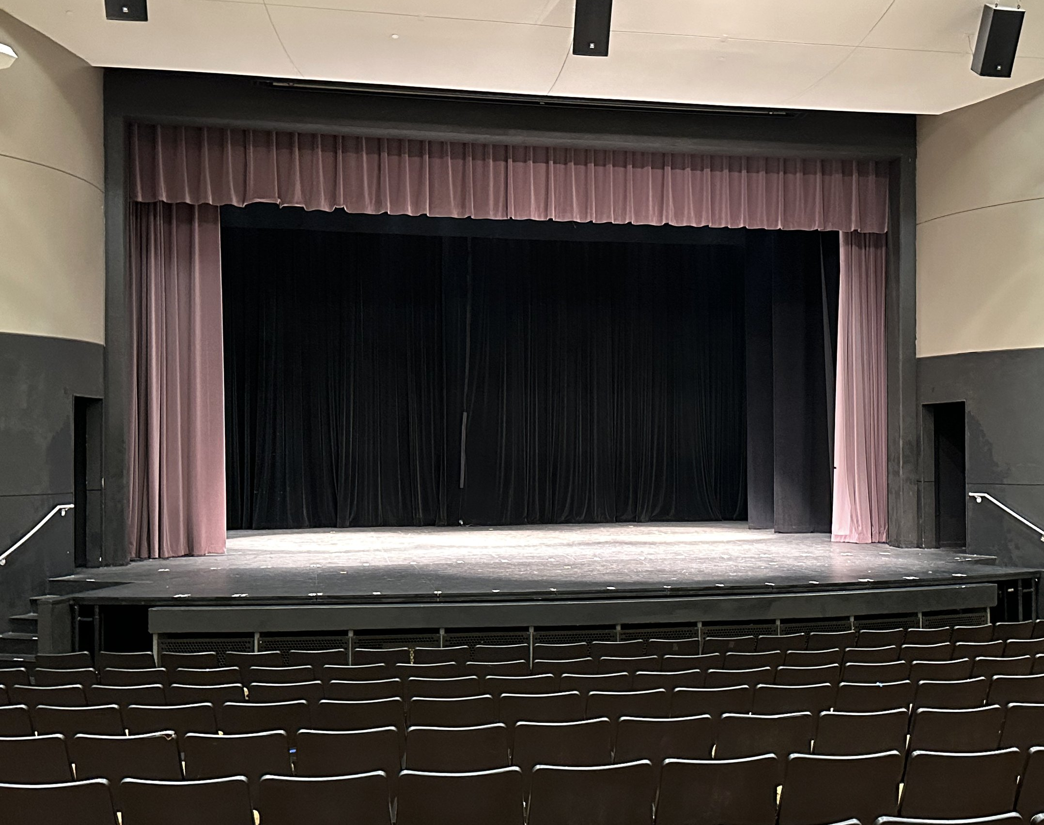
Community Auditorium and Theater
Provide access to the community for events, community theater troupe, beauty pageants, Sweet Sixteen, larger meetings, and other events for community benefit.

Slide 10

Community Meeting Room
Administrative Suite will become a large community meeting room for the District and Community.

Slide 11

Funding Opportunities
Marianna High School Alumni Challenge
Community Schools’ Challenge
Grants

